Slide 1
Object Oriented Programming
MC ITI Instructor Team

Slide 2
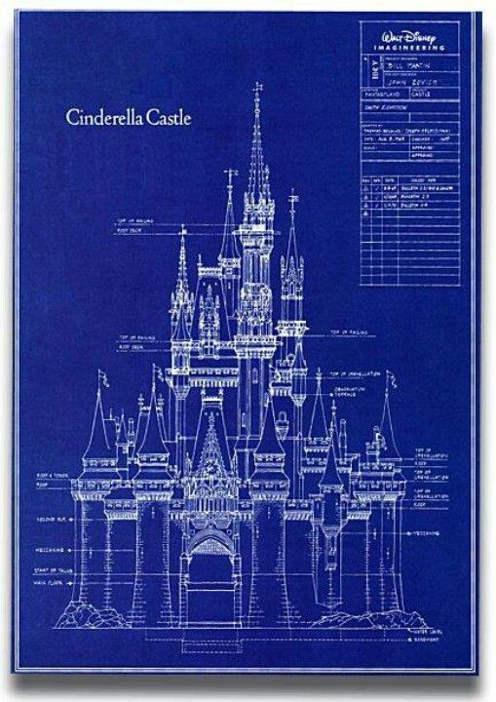
Class

Slide 3

Object (Instantiated Class)
Keyword = “new”
Castle disneyC = new Castle();

Slide 4



No castle yet

Slide 5

No access to the castle yet

Slide 6



Setter
.setGold()
.setMagnaCarta()
.setPrincess()

Slide 7
Setter
.getGold()
.getMagnaCarta()
.getPrincess()
Getter

Slide 8

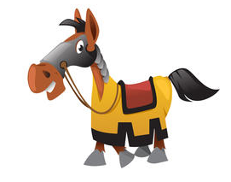


Setter
Method
.callTheCalvary()
.bringHorse()
.bringShield()
.bringMoreWeapon()
Getter

Slide 9
Setter
Method
Getter

Slide 10

Encapsulation
+
Public
Methods
-
Private
Variables

Slide 11
Inheritance & Composition

Slide 12
Class Relationships
Inheritance Keyword = “extends” “is a” relationship Parent - child | Abstract Class Keyword = “extends”
Composition No keyword “has a” relationship | Interface Keyword = “implements”

Slide 13
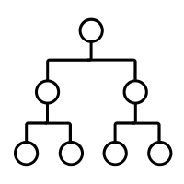
Inheritance
Car, Train, Ship → Vehicle
Swiss knife, kitchen knife,
butcher knife, switch blade,
butterfly knife → Knife

Slide 14

Inheritance
a “is a” b
A bike is a vehicle
A car is a vehicle
A truck is a vehicle
A plane is a vehicle
A ship is a vehicle

Slide 15







Composition
Vehicle has a:
Headlight
Steering wheel
Spark Plug
Windshield Wipers
Hub cap
Side mirror
Exhaust pipe
Note: Pan out on car, zoom in on components

Slide 16


Slide 17
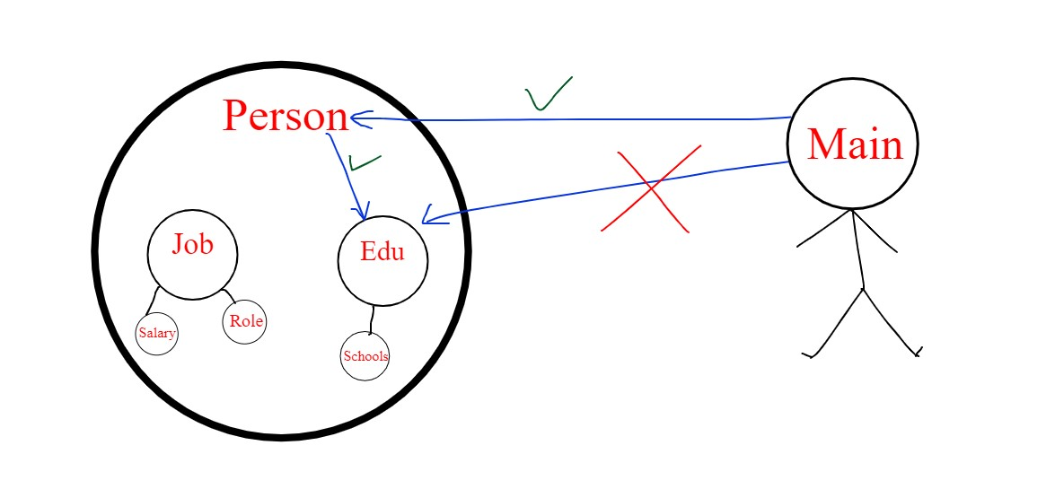
Method Chaining

Slide 18
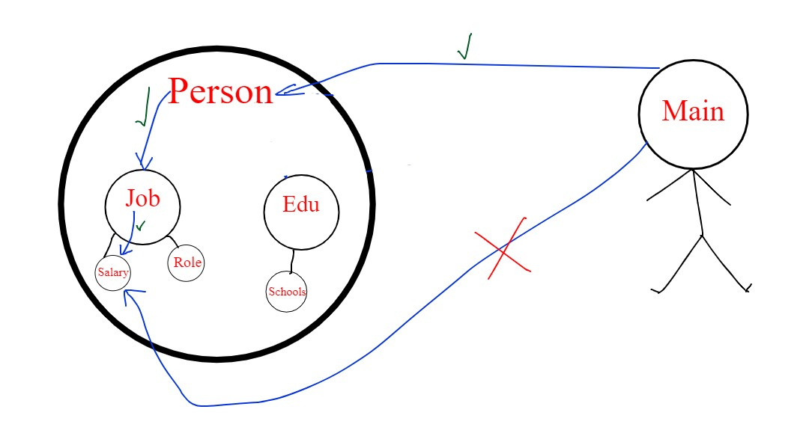
Method Chaining

Slide 19
Abstract Class & Interface

Slide 20
Abstract Class
Keyword = “extends”

Slide 21
Interface
Keyword = “implements”

Slide 22
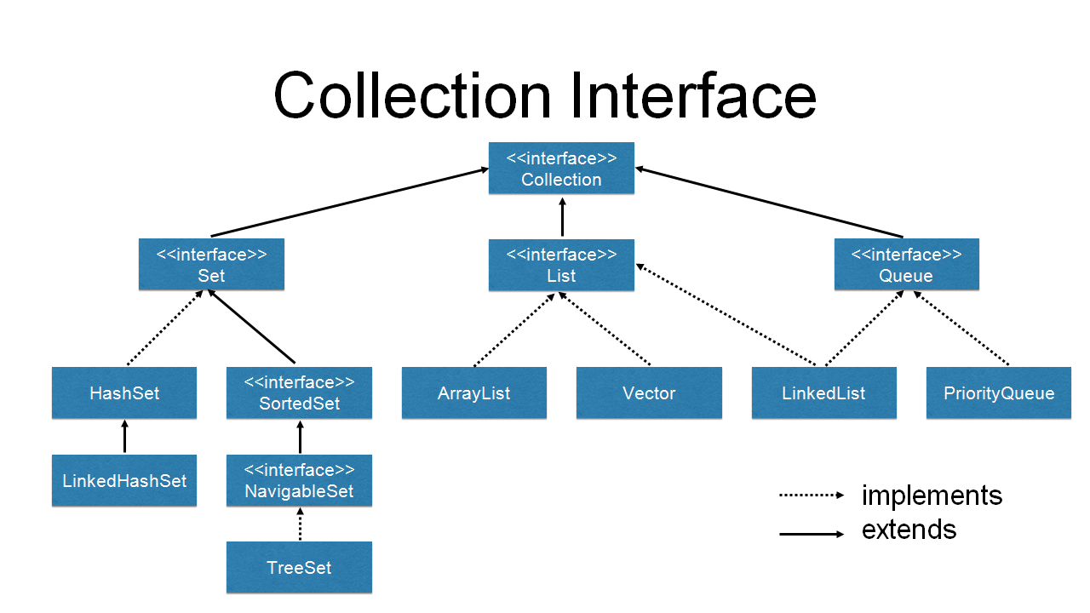
Inheritance using Interface

Slide 23
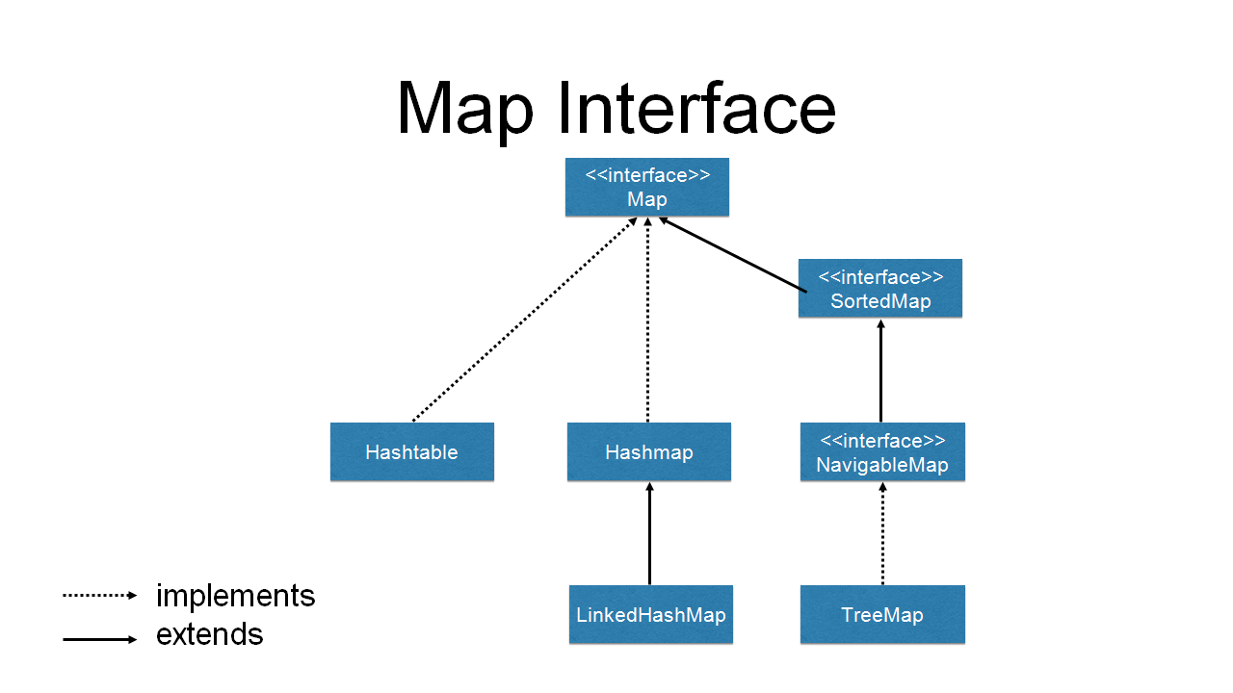
Inheritance using Interface

Slide 24
Commonly Used Collections
Collection Name | Insertion Order | Solution? | Duplicate detection
Set | No order | Use Collections.sort() | Doesn’t allow duplicate input
ArrayList | Order somewhat guaranteed |  | Accepts duplicate input
HashMap | No order | Use Collections.sort() | Doesn’t allow duplicate key, but allows duplicate value
Array | Ordered as they were added |  | Accepts duplicate input

Slide 25
Example Code
Simple OOP
https://github.com/mcjavabootcamp/BuildACastle
OOP with Inheritance
https://github.com/mcjavabootcamp/BuildACastle_Inheritance
OOP with Composition
https://github.com/mcjavabootcamp/BuildACastle_Composition
OOP with Interface
https://github.com/mcjavabootcamp/BuildACastle_Interface

